Slide 1
University of Diyala College of Engineering Dept. of Communications

Slide 2
“ Digital Communications “ By Haidar N. Al-Anbagi Lec (10) Time: (4 hrs) 2017

Slide 3
Differential pulse code modulation (DPCM):
When the idea of oversampling is exploited, the correlation between adjacent samples is increased as discussed earlier. However, the disadvantage of oversampling is the redundant unnecessary samples sent and received. These redundant samples do not have essential information. Therefore, removing these redundant symbols before the encoding process would increase the transmission efficiency dramatically and that is the idea of differential pulse code modulation (DPCM). Figure (5) shows the transmitter and the receiver of the DPCM.

Slide 4
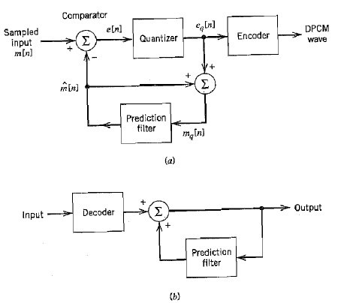
Figure (5) DPCM transmitter and receiver

Slide 5
The quantization input is
e[n] = m [n] – m⌃[n] (10)
and that represents the difference between the sampled input signal m[n]
and the prediction of it m⌃[n]. the predicted signal is produced by a prediction filter as shown in the figure. That means e[n] represents the
prediction error. The quantizer output can be expressed as:
$e_{q}\left[n\right]=e\left[n\right]+q[n]$ (11)
Where q[n] = the quantization error.

Slide 6
The input of the prediction filter is the summation of the quantization output and the predicted value. That is mathematically expressed as follows:
$m_{q}\left[n\right]$ = m⌃[n] + $e_{q}\left[n\right]$ (12)
Substitution the value of $e_{q}\left[n\right]$ from 11 in 12 results in the following equation:
$m_{q}\left[n\right]$ = m⌃[n] + $e\left[n\right]+q[n]$ (13)
But m[n]= e[n] + m⌃[n] from equation 10, therefore,
$m_{q}\left[n\right]$ = m[n] + $q[n]$ (14)
Equation 14 shows that the quantized version of the signal differs from the original signal by the quantization error q[n]. Finally, the output of the quantizer is encoded to produce the DPCM signal. The receiver of DPCM consists of an encoder and prediction filter. The prediction filter should be the same as the one used in the transmission process.

Slide 7
The processing gain:
The output SNR of the DPCM system is expressed as:
${SNR}_{0}= {σ_{M}}^{2}/{σ_{Q}}^{2}$ (15)
Where, ${σ_{M}}^{2}$ is the variance of the original input sample m[n].
${σ_{Q}}^{2}$ is the variance of the quantization error q[n].

Slide 8
We can rewrite the equation as follows:
${SNR}_{0}= {{(σ}_{M}}^{2}/{σ_{E}}^{2})$ . ( ${σ_{E}}^{2}/{σ_{Q}}^{2})$ = $G_{p}$ ${SNR}_{Q}$ (16)
Where, ${SNR}_{Q}$ is the signal-to-quantization noise ratio ${SNR}_{Q}= {σ_{E}}^{2}/{σ_{Q}}^{2}$
${σ_{E}}^{2}$= the variance of the prediction error.
$G_{p}$ = the processing gain = ${σ_{M}}^{2}/{σ_{E}}^{2}$
Therefore, when transmitting a signal, the variance ${σ_{M}}^{2}$ is fixed and that means the $G_{p}$ has to be maximized by designing a prediction filter with minimum ${σ_{E}}^{2}$.

